Slide 1
CS513
Knowledge Discovery and Data Mining
Cardiovascular Disease Prediction

Slide 2





Team Members
Prashant Mall Mrunal Salunke Pallavi Jaiswal Preet Dabhi
10459371 10467935 10478910 10459151

Slide 3
Problem Statement
To determine whether or not a person has Cardiovascular Disease:
An estimated 17.9 million people died from CVDs in 2019, representing 32% of all global deaths. Of these deaths, 85% were due to heart attack and stroke.
The provided dataset has a cardio label which indicates 1 for the cardiovascular disease present and 0 for the false report of cardiovascular disease
After EDA, we pass it through various algorithms for the final prediction of the person suspected to cardiovascular disease on the dataset
Data Set : https://www.kaggle.com/datasets/sulianova/cardiovascular-disease-dataset?select=cardio_train.csv

Slide 4
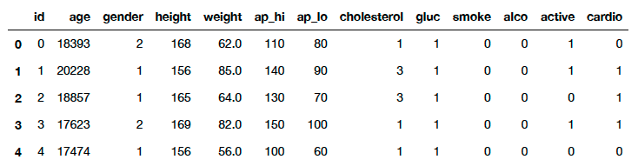
Data set Description
The Data set (cardio_train.csv) has 70K rows and 13 columns.
The data set has 70K records of patients and 11 features and target.
There are 3 types of input features:
Objective: factual information
Examination: results of medical examination
Subjective: information given by the patient
The task is predict if a person is susceptible to cardiovascular disease.

Slide 5
Data fields
Variable (column name) | Description | Type
age | Age | Objective
height | Height | Objective
weight | Weight | Objective
gender | Gender | Objective
ap_hi | Systolic blood pressure | Examination
ap_lo | Diastolic blood pressure | Examination
cholesterol | Cholesterol 1: normal, 2: above normal, 3: well above normal | Examination
gluc | Glucose 1: normal, 2: above normal, 3: well above normal | Examination
smoke | Smoking | Subjective
alco | Alcohol intake | Subjective
active | Physical activity | Subjective
cardio | Presence or absence of cardiovascular disease | Target

Slide 6
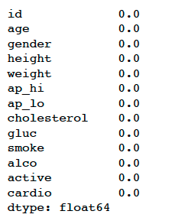
Exploratory Data Analysis
Dataset was clear from all null values

Slide 7
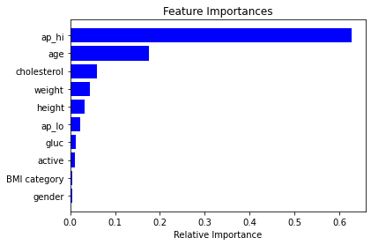
Feature Importance

Slide 8
Models Used
KNN
CART
Naïve Bayes
Logistic Regression
Random Forest

Slide 9
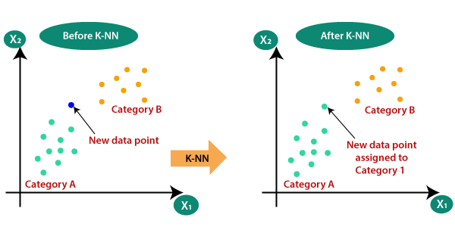
K nearest neighbors (KNN)
supervised machine learning algorithm
assumes that similar things exist in close proximity
to select the value of k, we run algorithm several times with different values of k and choose the k that reduces the number of errors
relies on labeled input data to learn a function that produces an appropriate output when given new unlabeled data.
used for classification but can be used to estimation and prediction tasks

Slide 10
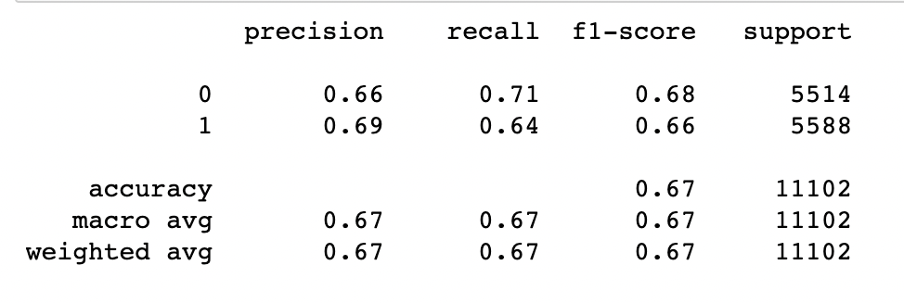
K nearest neighbors (KNN)

Slide 11
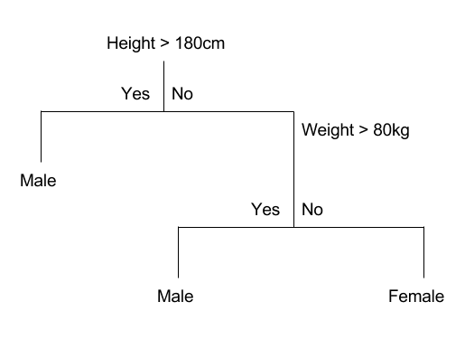
Classification and Regression Trees (CART)
CART is a tree-based classification and predictive method.
It uses recursive partitioning to split the training records into segments with similar output field values.
Each root node represents a single input variable (x) and a split point on that variable
The tree's leaf nodes contain an output variable (y) which is used to make the prediction.

Slide 12
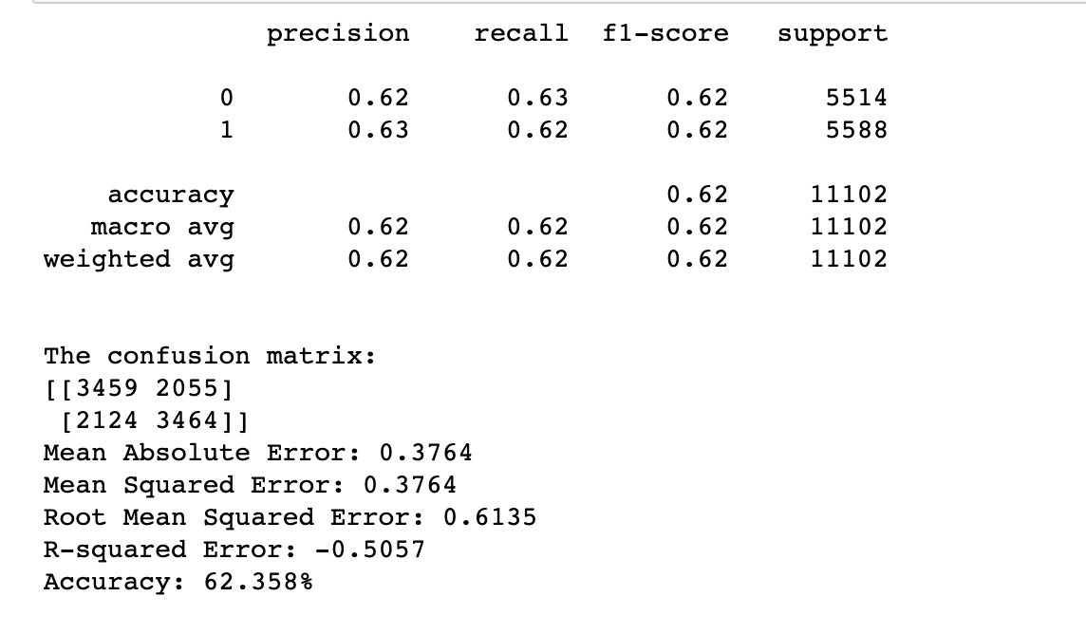
Classification and Regression Trees (CART)

Slide 13
Naïve Bayes
supervised machine learning algorithm
primarily used for classification
Bayes Theorem is used to solve classification problems by following a probabilistic approach, it finds the probability of an event occurring given the probability of another event that has already occurred.
all variables are independent of each other

Slide 14
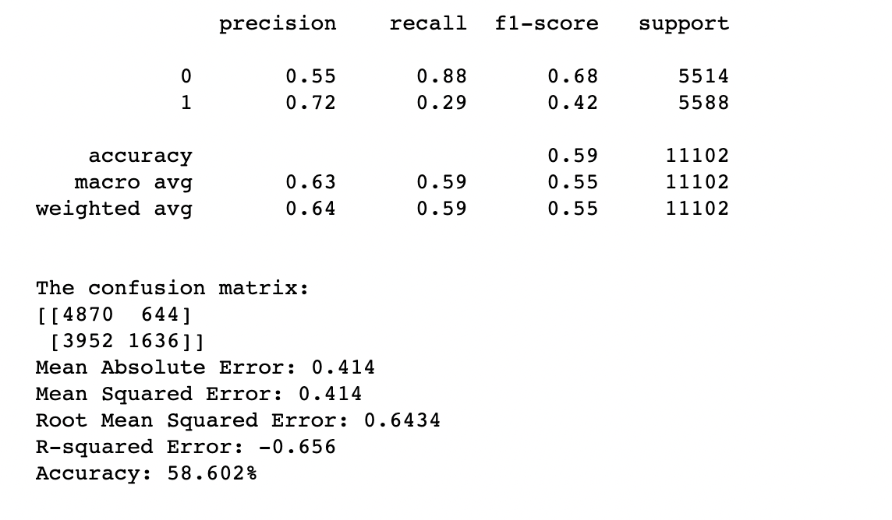
Naïve Bayes

Slide 15
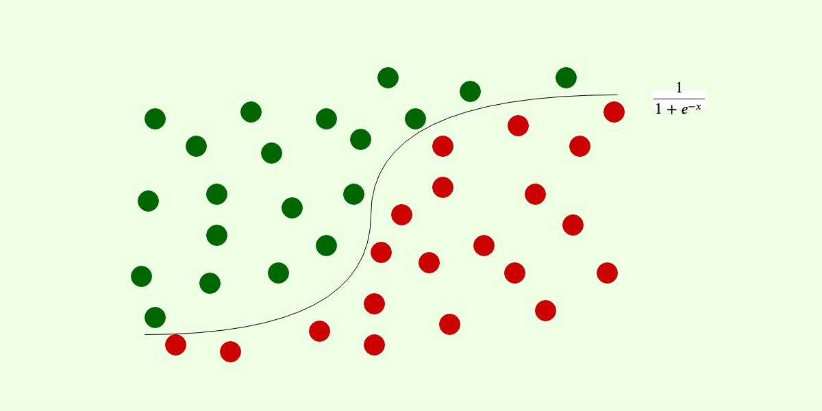
Logistic regression
Logistic Regression is a process of modelling the probability of a discrete outcome given an input variable.
It predicts by analyzing the relationship between one or more existing variables.

Slide 16
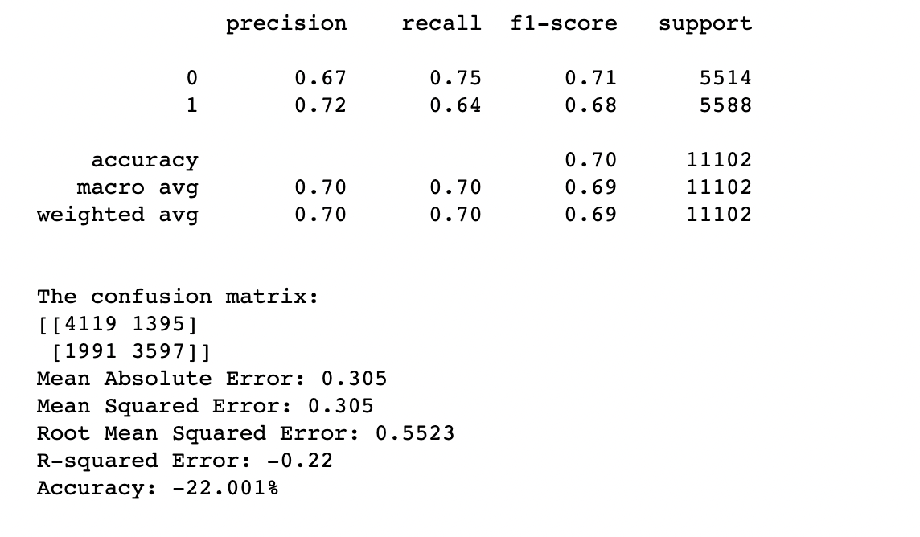
Logistic regression

Slide 17
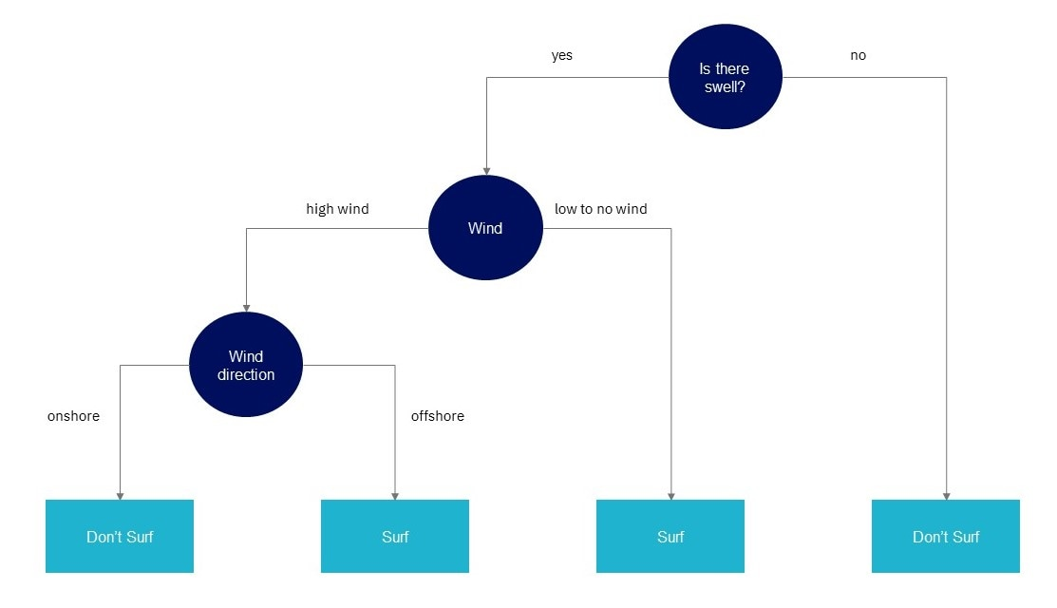
Random Forest Classifier
Random Forest is a supervised Machine Learning Algorithm that is used in Classification and Regression problems. It is one of the most used algorithms due to its simplicity and diversity.
Random Forest is made of multiple decisions trees. These questions make up the decision nodes in the tree, acting as a means to split the data.
Each question helps an individual to arrive at the final decisions, which would be denoted as the leaf node.

Slide 18
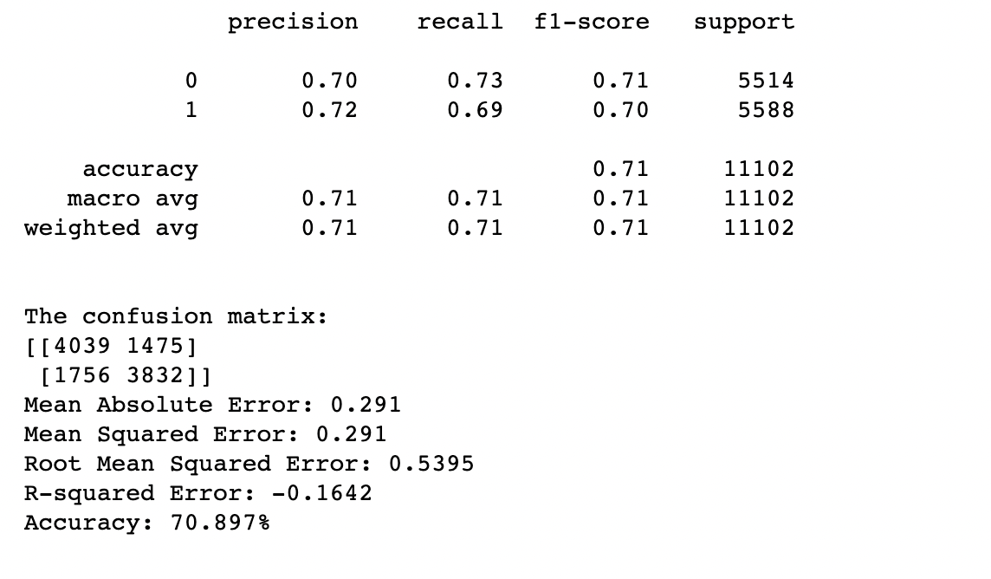
Random Forest Classifier

Slide 19
Comparison and Conclusion
Here we are comparing the different values of precision , recall and F1 score of various algorithms to determine which of the them gives the best accuracy.
Algorithms | Precision | Recall | F1-Score
KNN | 0.69 | 0.64 | 0.66
CART | 0.63 | 0.62 | 0.62
Naive Bayes | 0.72 | 0.29 | 0.42
Logistic Regression | 0.72 | 0.64 | 0.68
Random Forest | 0.72 | 0.69 | 0.70

Slide 20
Thank You

